Slide 1

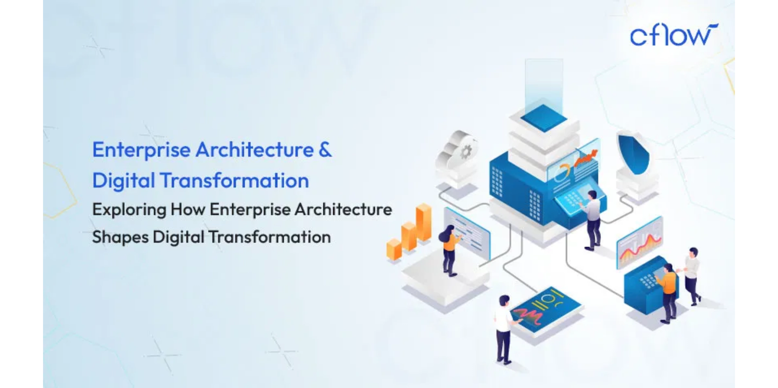
Comprehensive Service Improvement Plan
Transition to Enterprise-Grade, AI-Driven SaaS (2025-2027)

Slide 2

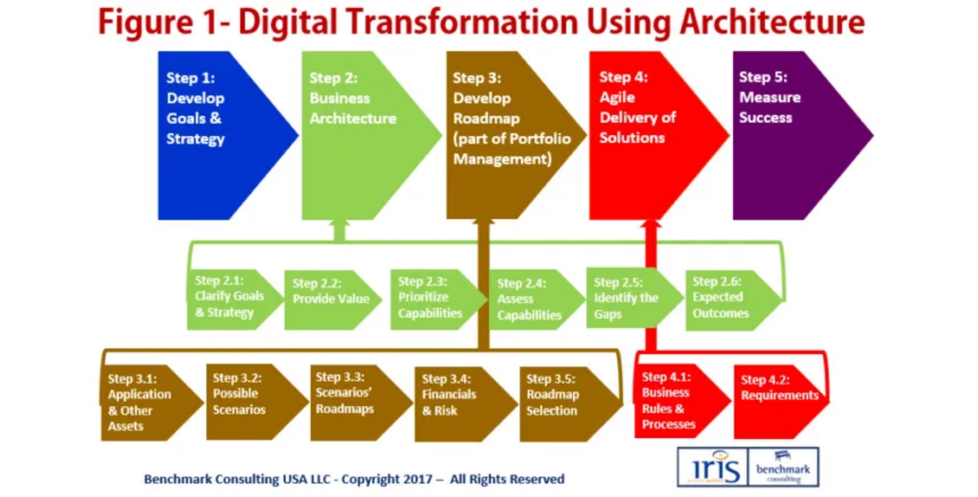
Executive Summary
Architecture
Current: Docker Compose on single VPS with basic Traefik routing.
Recommendation:
Strategic migration to Kubernetes
for true horizontal
scaling and high availability.
Security
Current: Secrets in environment variables, limited internal network
control.
Recommendation: Implement
Zero-Trust Network Access (ZTNA)
and
Centralized Secret Management.
Mandate
PSRA-LTSD
Transition from functional deployment to
enterprise-grade, scalable,
Current: Core features require activation/completion.
secure, and AI-driven SaaS solution
, leveraging the Q3 2025 codebase.
Recommendation: Integrate
LangGraph for sub-2 second, 99.8%
accurate Origin Calculation Engine
.
Methodology
Evidence-Based, Zero-Trust, and Change-Controlled approach to ensure security, stability, and auditability.
AI/Ops
Current: Separate services (VPS Manager, N8N, Claude Chat).
Recommendation: Consolidate under a unified
AI Orchestrator
and
integrate a Local LLM for automated operations.

Slide 3

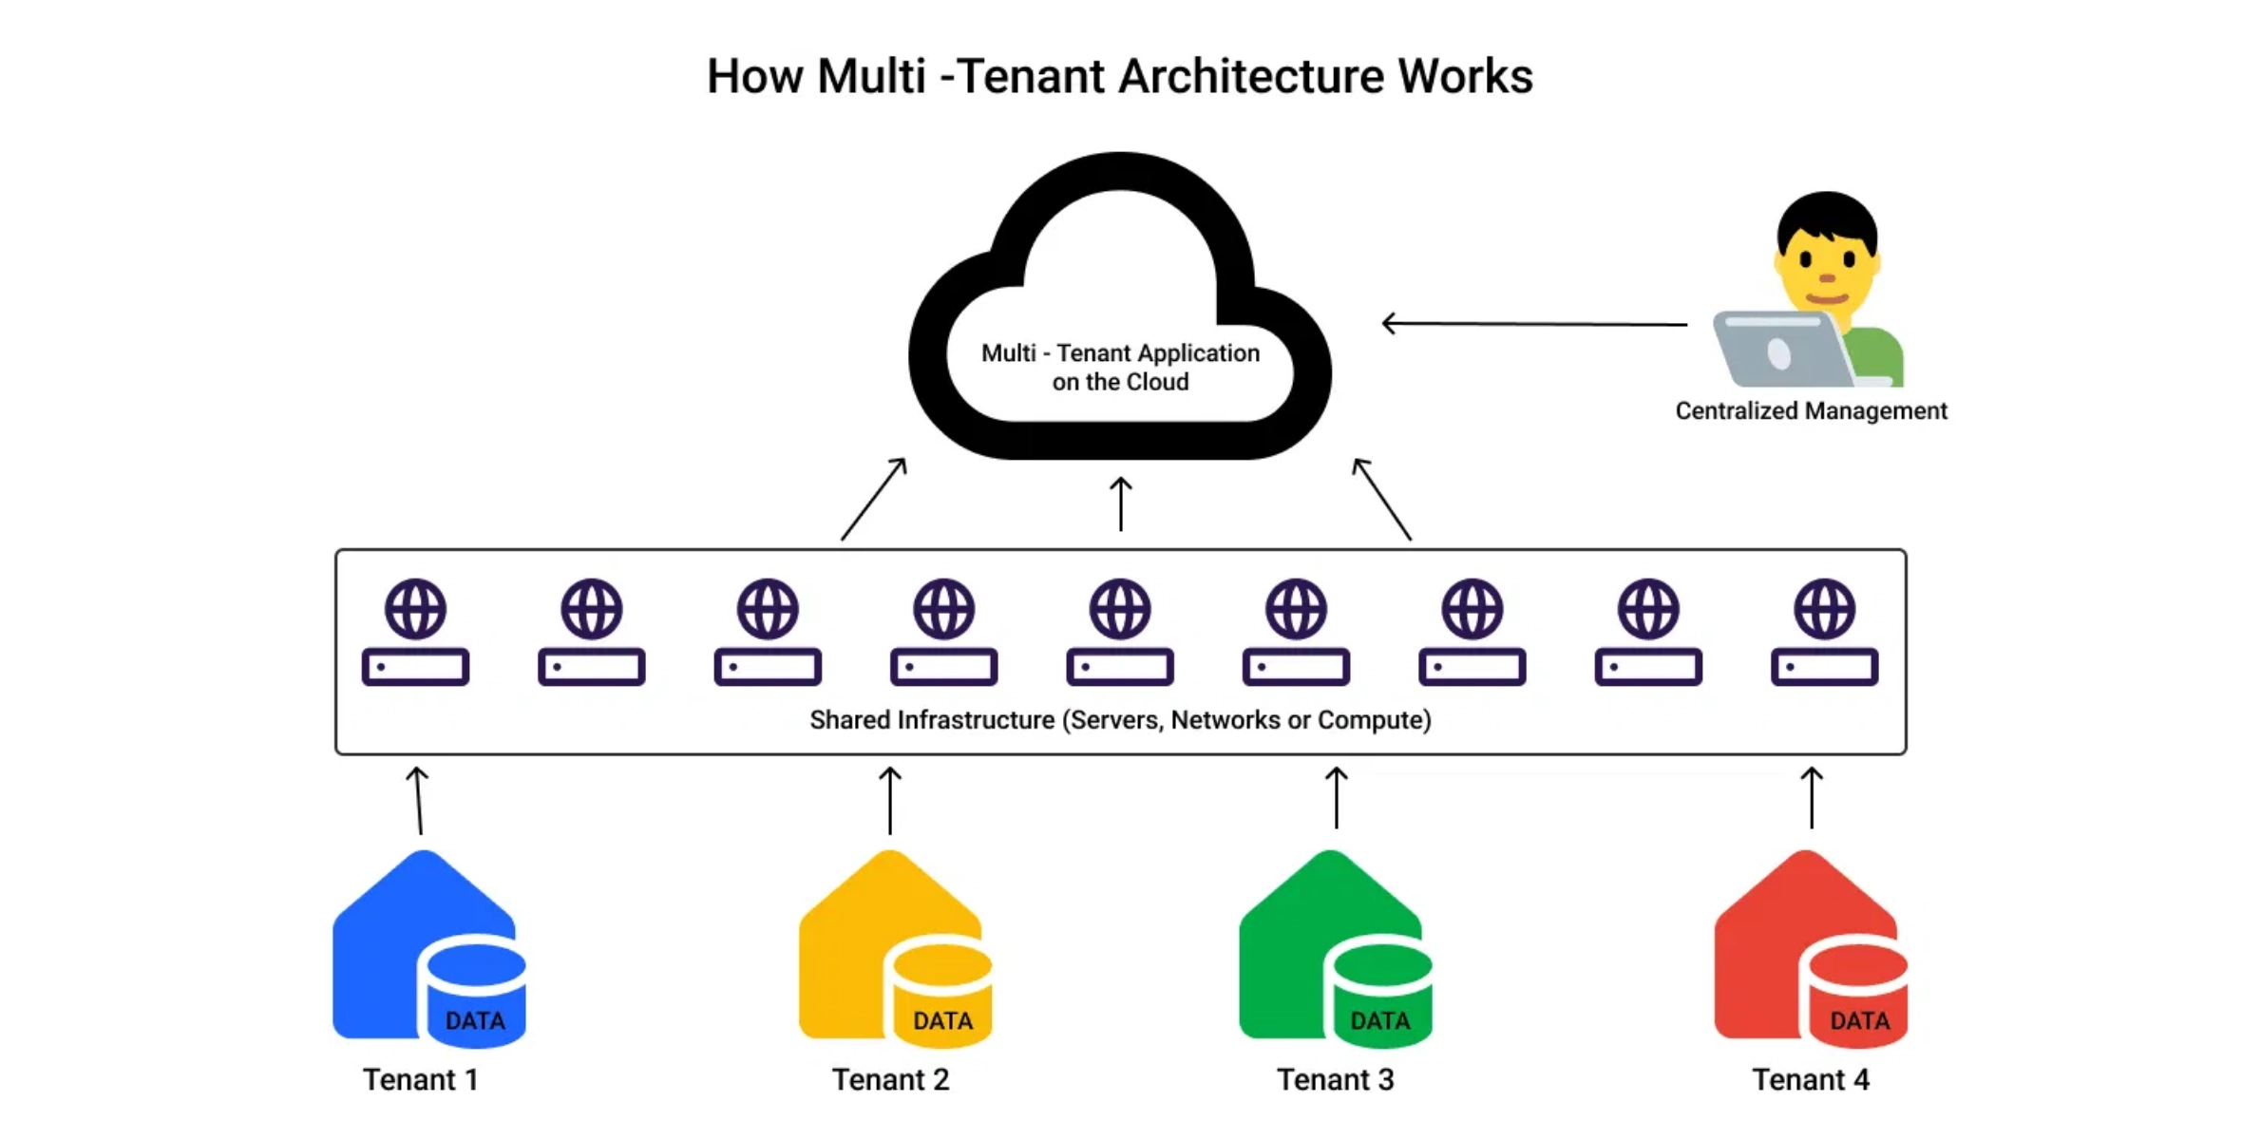






Current State Analysis
Service Inventory and Domain Mapping
Service
Domain Mapping
Port
RentGuy API/Onboarding
rentguy.sevensa.nl
8000
PSRA-LTSD
psra.sevensa.nl
8001
VPS Manager
ai.sevensa.nl
8002
WPCS Backend
wpcs.sevensa.nl
8003
Claude Chat
claude.sevensa.nl
8004
Multi-Tenant Docker and Traefik Configuration
N8N
n8n.sevensa.nl
8005
Isolation:
Separate Docker containers for each service
Trading Dashboard
trading.sevensa.nl
8006
Routing:
Traefik as reverse proxy with SSL termination
LangGraph
langgraph.sevensa.nl
8007
Networking:
Shared external Docker network ('web')
Codebase Q3 2025 Analysis
Modern frameworks (FastAPI, React, Prisma)
Service conflicts and integration challenges identified
Missing core functionalities, particularly within PSRA

Slide 4

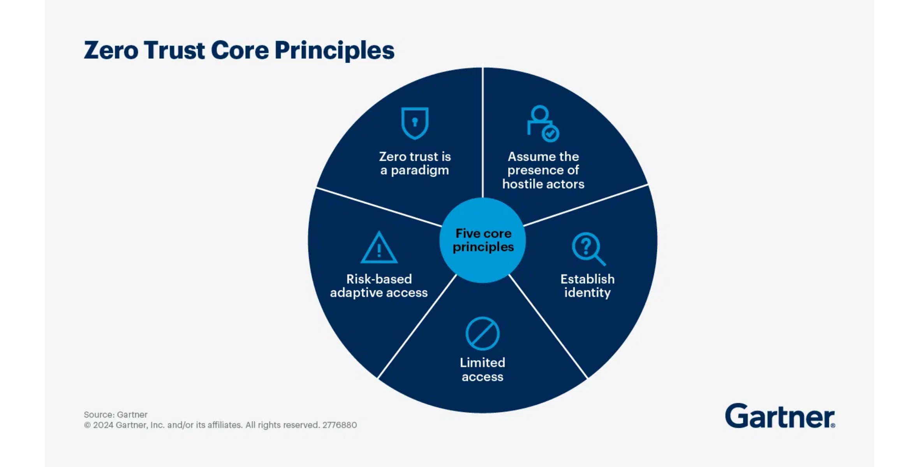








Security Hardening & Compliance
Centralized Secret Management
HashiCorp Vault Integration
Replace environment variables in Docker Compose files with a centralized, encrypted secret management solution.
Dynamic Secrets
Generate short-lived credentials for databases and APIs on demand, reducing the risk of credential exposure.
Zero-Trust Network Access (ZTNA)
Automated Rotation
Implement automated rotation of critical credentials to minimize the impact of potential breaches.
Micro-segmentation
Define strict network policies between Docker containers to minimize the blast radius in case of a breach.
Container Security Best Practices
Identity-Centric Access
Rootless Containers
Integrate a centralized Identity Provider (IdP) for all services, ensuring authentication before authorization.
Run all containers as non-root users to prevent privilege escalation attacks.
Continuous Verification
Image Scanning
Implement continuous monitoring of user and service behavior to detect anomalies.
Integrate automated image scanning tools (e.g., Clair, Trivy) into the build pipeline to identify vulnerabilities.

Slide 5

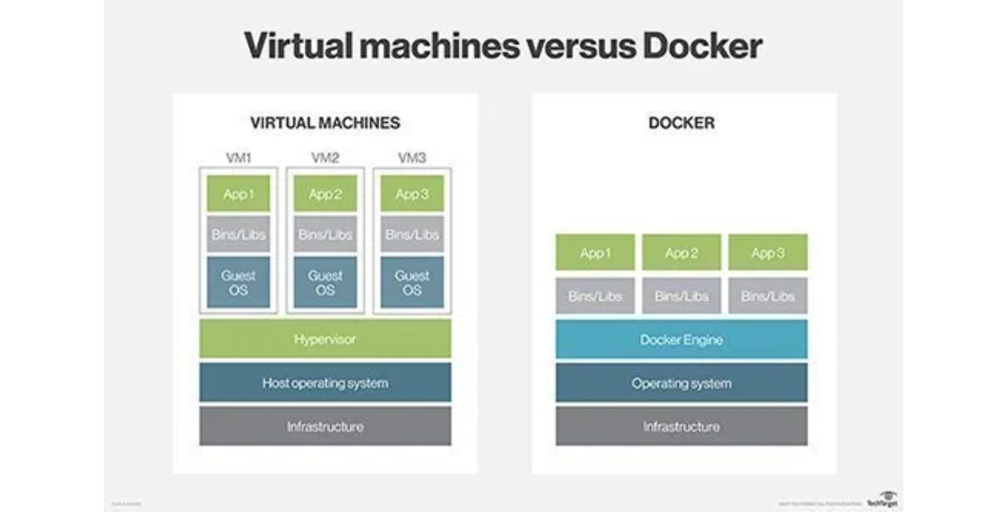








Multi-Tenant Optimization & Scalability
Centralized Logging and Monitoring (CLM)
Prometheus:
Collects metrics (CPU, memory, request latency)
Grafana:
Real-time visualization of service health
Loki/ELK Stack:
Centralized application logs
Database Isolation Strategy
Performance Isolation:
Separate database instance
per large enterprise
client (e.g., Witcom)
Security Isolation:
Shared database with
strict schema separation
for
smaller tenants
Standardized Service Orchestration
Credential Management:
Unique database credentials managed by
Feature
Current (Docker Compose)
Proposed (Kubernetes)
Centralized Secret Manager
Manual, single host
Automated, horizontal
Benefits of Proposed Architecture
Scaling
External scripts
Automatic restart
Elasticity:
Scale individual services based on demand
Self-Healing
Reliability:
Achieve 99.99% uptime target
Load Balancing
Basic Traefik routing
Advanced L4/L7 Ingress
Performance:
Support PSRA's sub-2 second certificate generation
Configuration
Static YAML files
Dynamic ConfigMaps

Slide 6

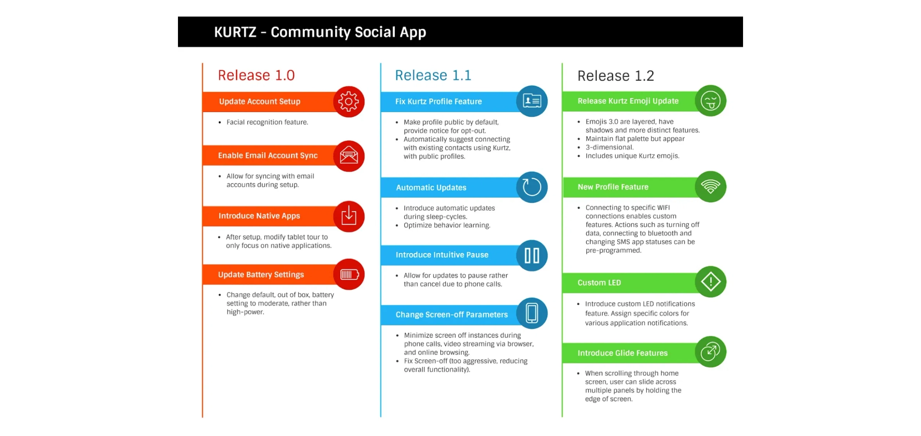






Service-Specific Roadmaps
WPCS (WordPress Control Suite)
Automated Malware Scanning & Removal
High
One-Click Staging/Production Sync
High
Multi-Site Management Dashboard
Medium
Integrated Caching and CDN Management
Medium
VPS Manager & AI/Orchestration
Unified AI Orchestrator API Gateway
High
Automated Health Checks & Monitoring
High
One-Click/Automated Rollback Feature
High
RentGuy (PropTech)
Local LLM Integration (2026 Roadmap)
Medium
Enterprise SSO/SAML Integration
High
Advanced Inventory Management (Digital Twin)
High
Technical Refactoring
Two-Way CRM Integration
Medium
RentGuy API Performance & GraphQL Endpoint
PSRA Asynchronous Processing (Message Queues)
PSRA-LTSD (Trade Compliance)
WPCS Backend Microservices Architecture
Next-Gen Origin Calculation Engine (LangGraph)
Critical
Integrated HS Codes & Trade Agreement Database
High
ERP Connector Module (AMF/Witcom, SAP)
Critical

Slide 7

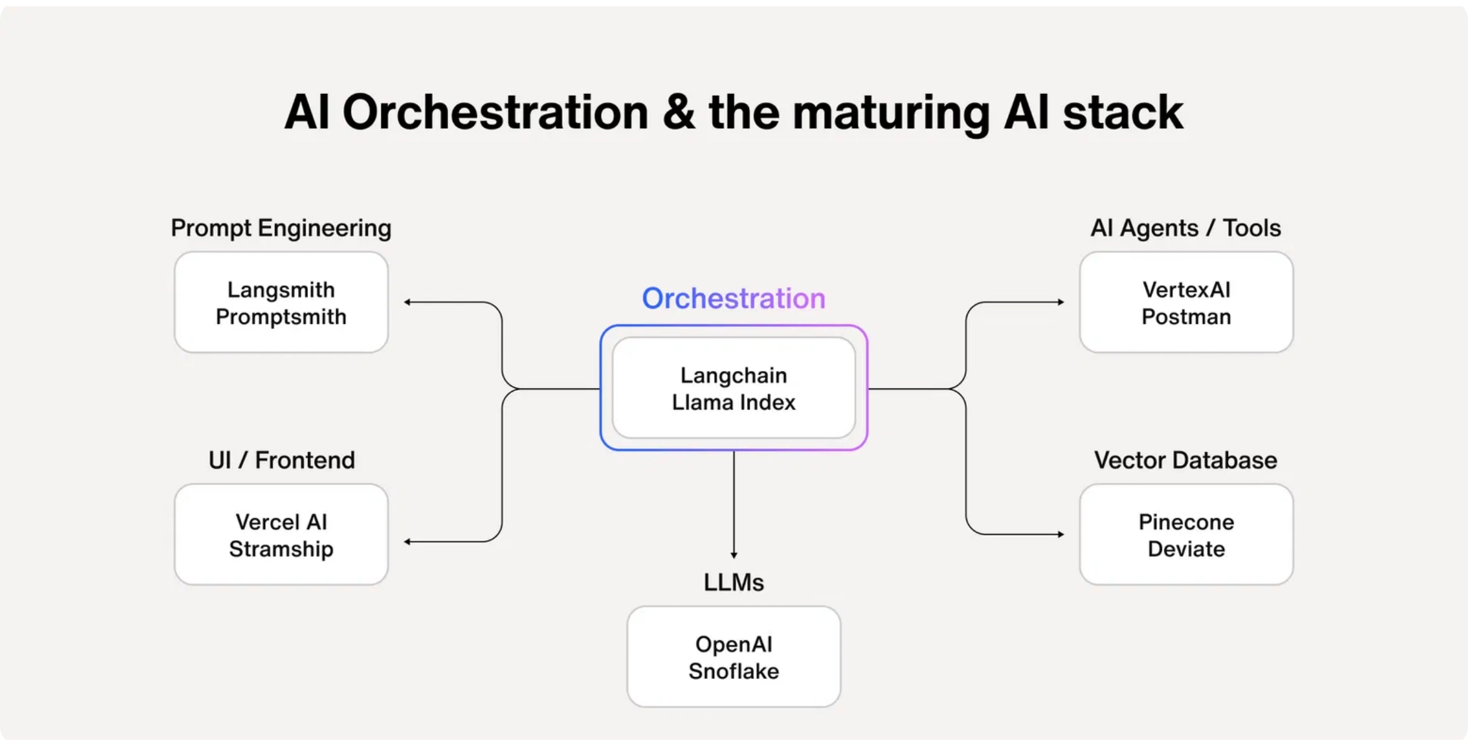
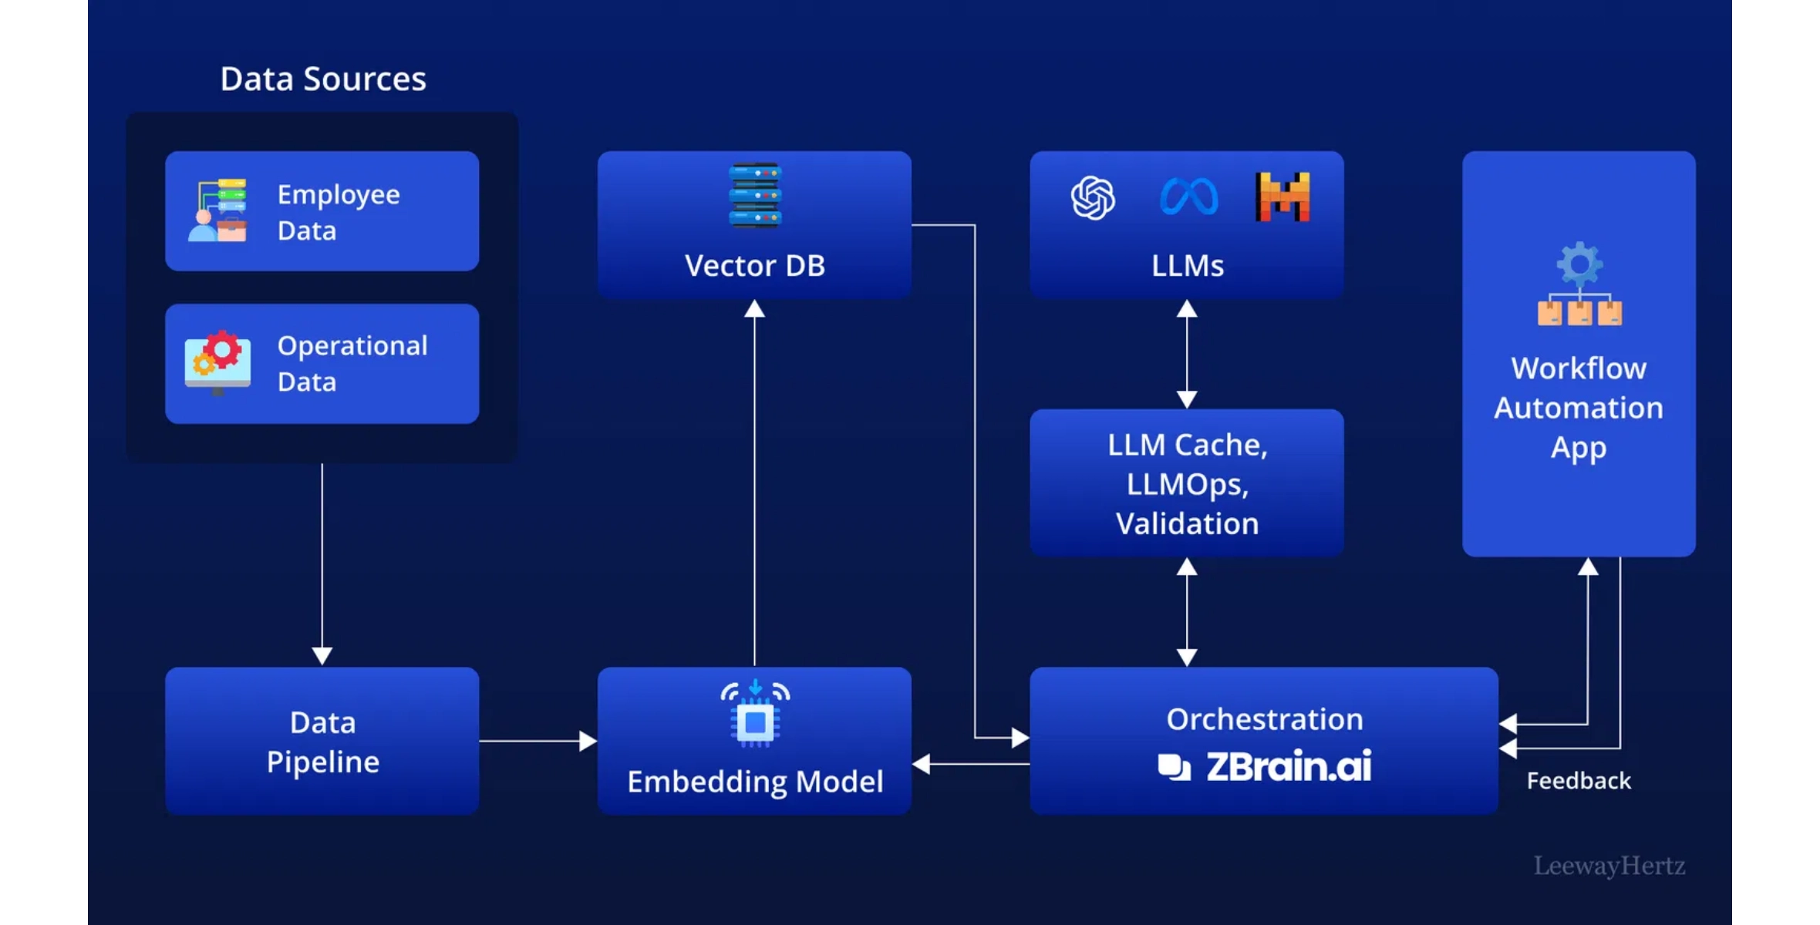







AI Orchestration Layer
Local LLM for VPS Orchestration (2026 Roadmap)
LangGraph and N8N Synergy
Model Requirements
LangGraph: AI Reasoning Engine
Quantized 7B or 13B parameter model (e.g., Llama 3 or Mistral) runnable on VPS hardware for cost-effective, low-latency operation.
Complex, multi-step agentic workflows for PSRA's certificate generation
logic and VPS Manager's decision-making process.
N8N: Integration and Automation Backbone
Functionality
External API calls, data transformation, and service connections (e.g.,
Natural language command interpretation (e.g., "Rollback RentGuy to yesterday's state") translated into shell/API calls for automated operations.
RentGuy's onboarding form to CRM integration).
Claude Chat: Enterprise-grade Conversational Interface
Support and documentation access integrated into RentGuy/PSRA
portals via API.
Deployment
Utilize Ollama or vLLM within a dedicated Docker container for efficient GPU/CPU utilization and seamless integration with existing services.
Unified AI Orchestrator (ai.sevensa.nl)
Central API gateway and orchestration layer for all AI services,
providing consistent access patterns and monitoring.

Slide 8

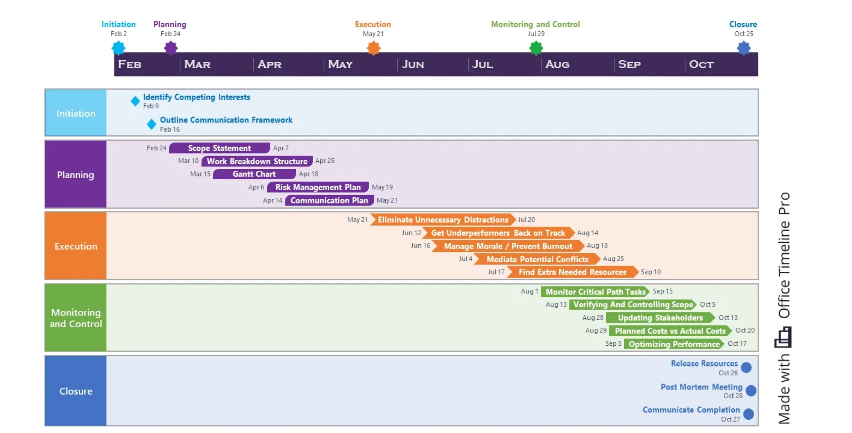




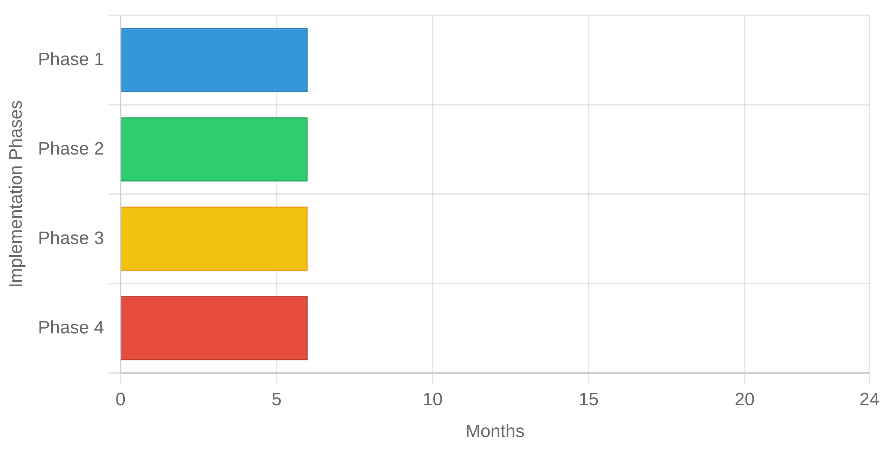

24-Month Implementation Roadmap
Phase 3 (13-18 Months): Scalability & Orchestration
Kubernetes Migration Strategy
WPCS Microservices Refactoring
AI Orchestrator API Gateway
Phase 4 (19-24 Months): Innovation & Optimization
Local LLM Integration for VPS Orchestration
Full WPCS Managed Hosting Feature Set
RentGuy GraphQL API
Phase 1 (0-6 Months): Stabilization & Security Hardening
ZTNA implementation
Centralized Secret Management
Centralized Logging & Monitoring (Prometheus/Grafana)
Phase 2 (7-12 Months): Core Feature Implementation
PSRA LangGraph Engine
PSRA ERP Connector (Witcom Pilot)
RentGuy Enterprise SSO
Security
Core Features
Scalability
Innovation

Slide 9

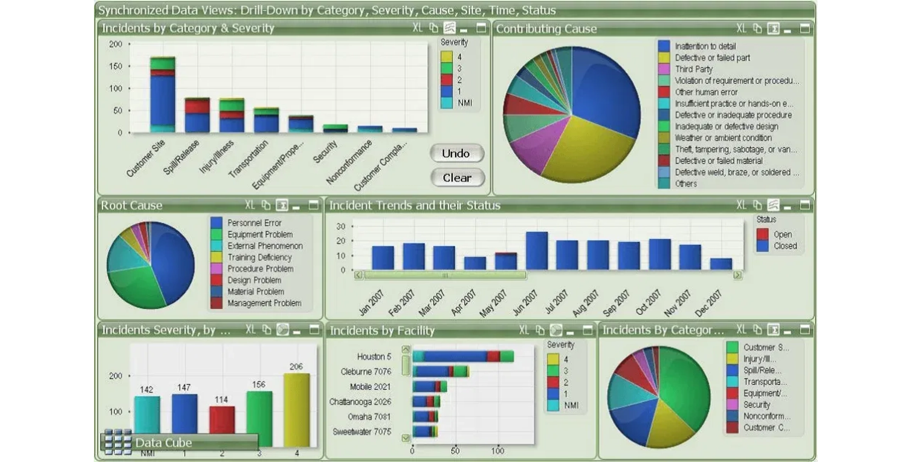


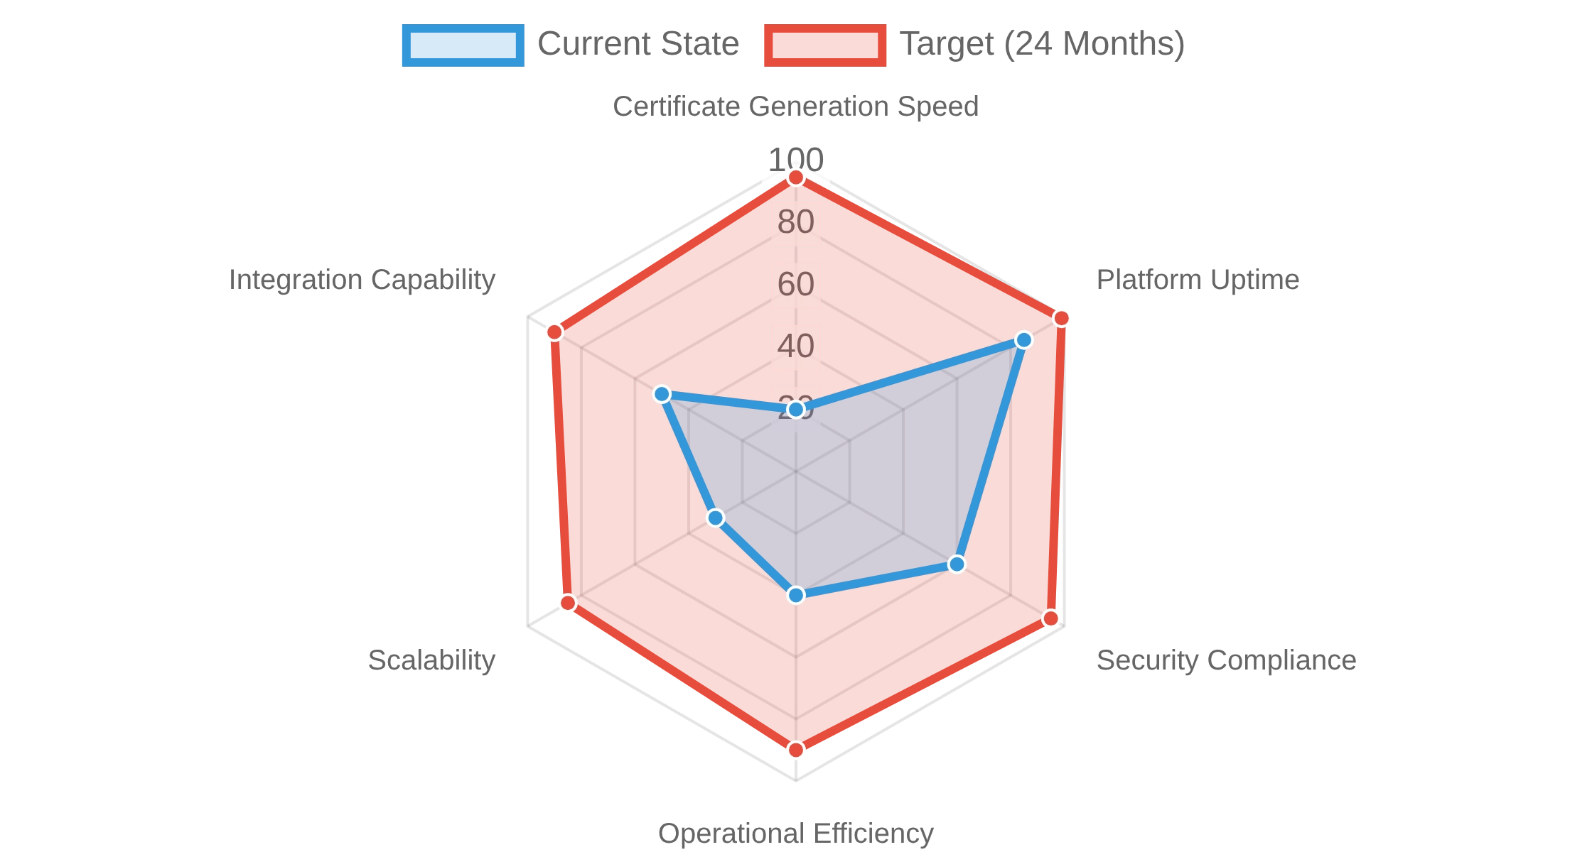
ROI & Business Impact
Projected ROI Drivers
Direct Cost Savings:
99.7% reduction in certificate generation time
translates to significant labor cost savings.
Customer Retention:
Improved uptime and performance increases
customer satisfaction and reduces churn.
Risk Mitigation:
Zero-Trust security reduces the likelihood and potential
impact of security breaches.
Operational Efficiency:
AI automation reduces the need for manual
intervention and debugging.
Performance Improvement Projection
Key Performance Metrics
PSRA Certificate Time
30-60 minutes
<2 seconds
Platform Uptime
~99.5%
99.99% (Four Nines)
Security Compliance
Moderate
Enterprise-Grade (Zero-Trust)
Operational Overhead
High (Manual Intervention)
Low (AI-Automated)

Slide 10

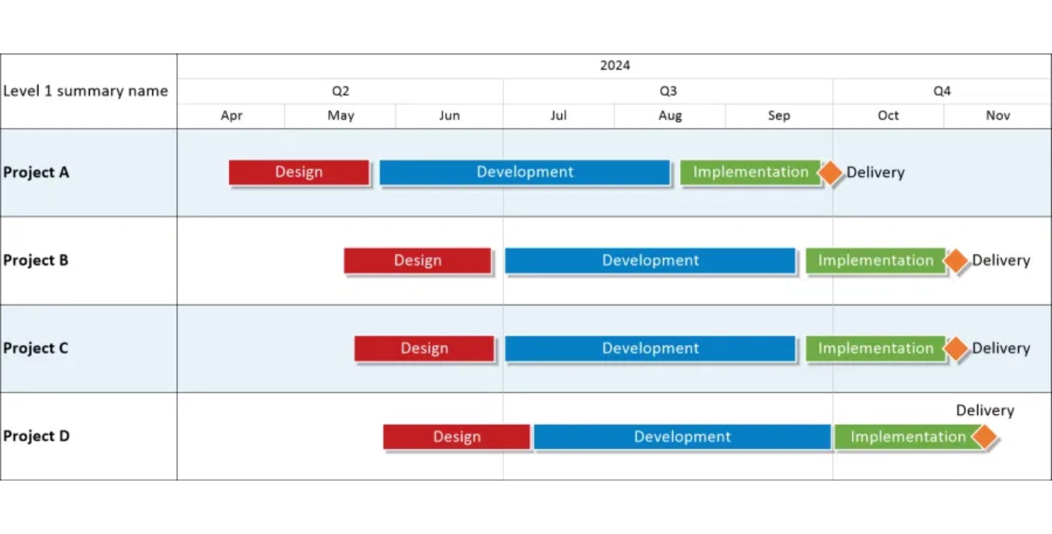
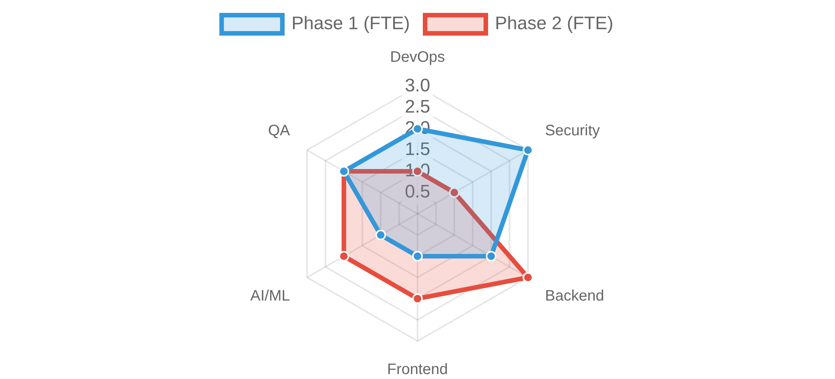
Next Steps & Recommendations
1
Immediate Actions (Next 30 Days)
3
Critical Path Milestones
Form cross-functional implementation team
ZTNA Implementation Complete
Conduct security audit of current environment
Month 3
Zero-Trust Network Access fully operational
Establish monitoring baseline metrics
Prioritize PSRA Origin Engine development
Month 6
Monitoring Stack Deployed
Prometheus/Grafana with custom dashboards
2
Key Success Factors
Evidence-Based, Zero-Trust methodology
Month 9
PSRA Origin Engine MVP
Phased implementation with clear milestones
First sub-2 second certificate generation
Comprehensive testing with 15 personas
Regular stakeholder communication
Month 12
Witcom Pilot Launch
First enterprise client on new platform
4
Resource Requirements

